Slide 1
Forecasting Sales Of Store Using IBM Watson Studio
PRESENTED BY:
TEAM NO:0015
18UK1A0518-Gowroju Laxmi priya
18UK1A0567-Challakonda Srichandana
18UK1A0523-Junnuthula Akshaya
18UK1A0531-Manda Manasa

Slide 2
OUTLINE
Introduction
Objective
DATA
MODEL BUILDING
ALGORITHMS
DATA Visualisation
Software requirements
conclusion

Slide 3
INTRODUCTION
Sales forecasting is an essential task for the management of a store. Being able to estimate the number of products that a retail store is going to sell in the future will allow the owners of these shops to prepare the inventory that they will need.
In this project, we are building a system that analyses the previous trends of sales which includes sales on various days and predicts future sales. The goal of this project is to forecast the sales of stores by using time series analysis. Here time series analysis algorithms such as RNN (Recurrent Neural Network) & LSTM (Long Term Short Memory) are used to analyze the past trends of sales of stores. Create and deploy flask-based web Application and integrate AI model to it.
The objective of the project is to build a web application where the user gives the last ten days' sales values and gets the prediction for the 11th day which is showcased on UI.

Slide 4
OBJECTIVE
By the end of this project you will be able to:
Know fundamental concepts and techniques of time series forecasting and LSTM
Gain a broad understanding of time series data.
Know how to split the data for time series forecasting.
Know how to build a web application using the Flask framework.

Slide 5
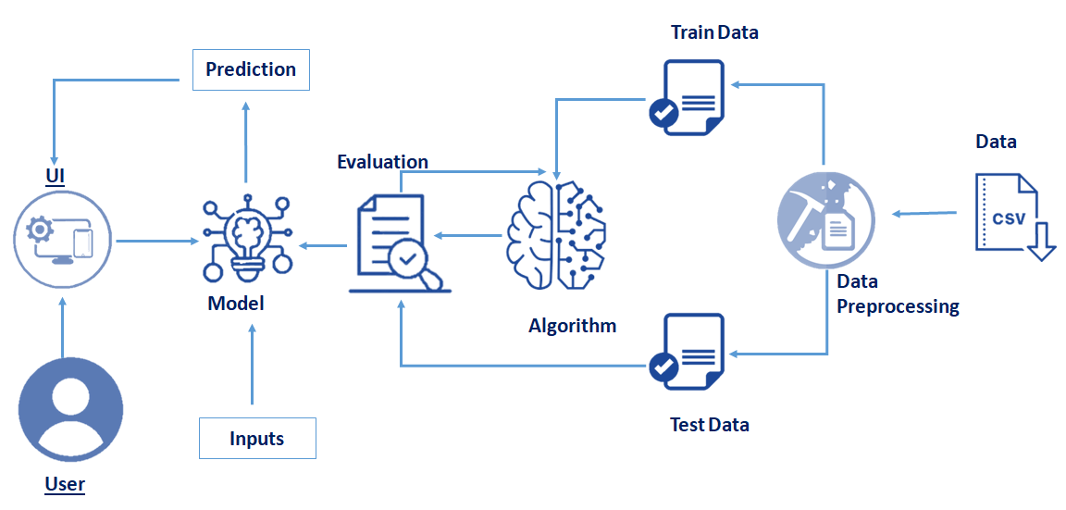
TECHNICAL ARCHITECTURE

Slide 6
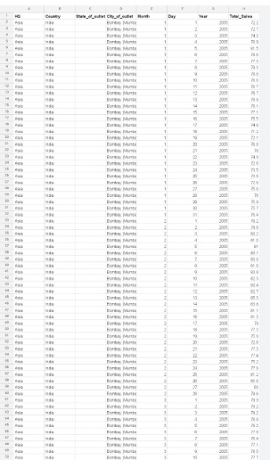
DATA
Our Sales dataset contains 17537 rows and 8 columns
1. HQ - This attribute represents HeadQuarters of the company.
2. Country - This attribute represents the country of the outlet.
3. State_of_outlet - This attribute represents the state of the outlet.
4. City_of_outlet - This attribute represents the city of the outlet.
5. Month - This attribute represents the month(ranging from 1 to 12 )
6. Day - This attribute represents a day of the month(ranging from 1 to 31)
7. Year - This attribute represents the year(ranging from 2005 to 2016)
8. Total_Sales - Target variable (total sales on a particular day). It contains total sales from 19886 to 2018.

Slide 7
MODEL BUILDING
A machine learning model is a file that has been trained to recognize certain types of patterns. You train a model over a set of data, providing it an algorithm that it can use to reason over and learn from those data.
Model Building Includes:
Import the model building Libraries
Initializing the model
Adding LSTM Layers
Adding Output Layer
Configure the Learning Process
Training the model
Model Evaluation
Save the Model
Test the Model

Slide 8
ALGORITHMS
TIME SERIES ANALYSIS ALGORITHM
Time series analysis is a method used for analysing time series data in order to extract meaningful statistical information from the data. Time series forecasting however, is all about predicting future values based on previously observed values over time.
The goal of this project is to forecast the sales of stores by using time series analysis. Here time series analysis algorithms such as RNN (Recurrent Neural Network) & LSTM (Long Term Short Memory) are used to analyze the past trends of sales of stores.

Slide 9
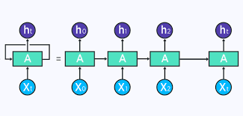
RNN (Recurrent Neural Network)
Recurrent neural networks (RNN) are the state of the art algorithm for sequential data and are used by Apple's Siri and Google's voice search. It is the first algorithm that remembers its input, due to an internal memory, which makes it perfectly suited for machine learning problems that involve sequential data.

Slide 10
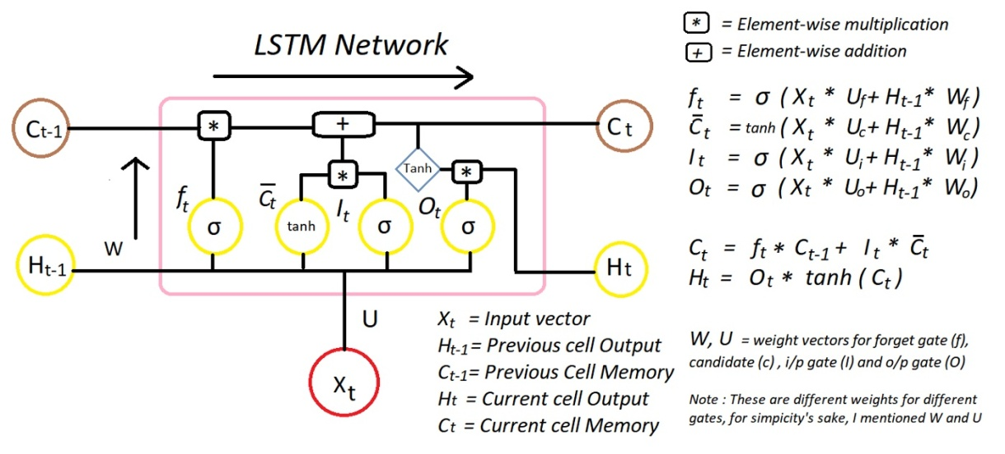
LSTM( Long short-term memory )
Long short-term memory (LSTM) is an artificial recurrent neural network (RNN) architecture used in the field of deep learning. ... LSTM networks are well-suited to classifying, processing and making predictions based on time series data, since there can be lags of unknown duration between important events in a time series.

Slide 11
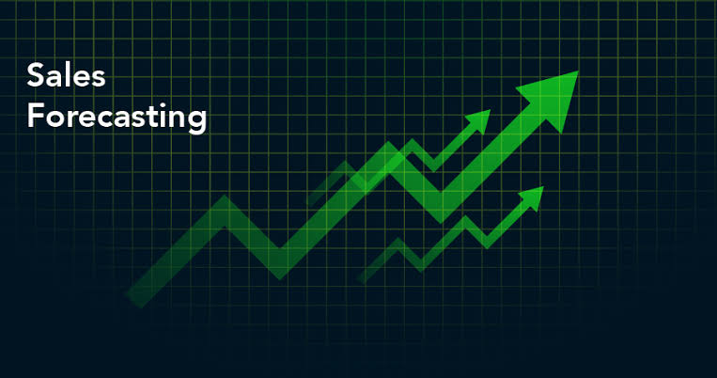
DATA VISUALISATION
Data visualization is where a given data set is presented in a graphical format. It helps the detection of patterns, trends and correlations that might go undetected in text-based data.
Understanding your data and the relationship present within it is just as important as any algorithm used to train your machine learning model. In fact, even the most sophisticated machine learning models will perform poorly on data that wasn’t visualized and understood properly.
To visualize the dataset we need libraries called Matplotlib and Seaborn.
The Matplotlib library is a Python 2D plotting library which allows you to generate plots, scatter plots, histograms, bar charts etc.

Slide 12
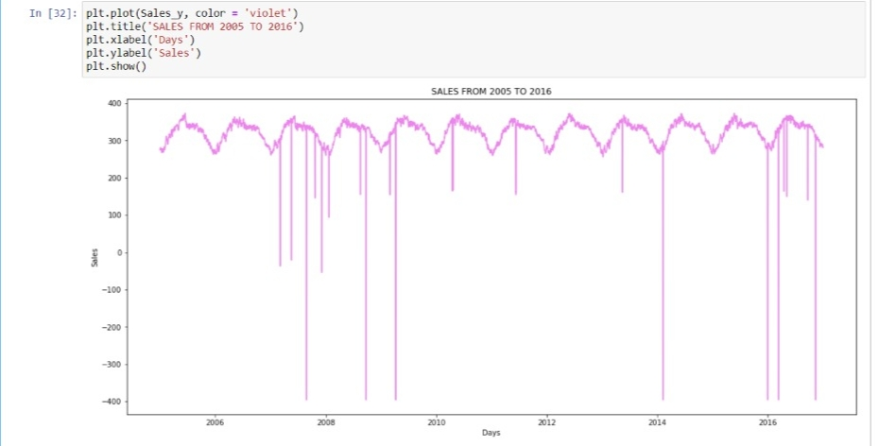
DATA VISUALIZATION
Sales from 2005 to 2016

Slide 13
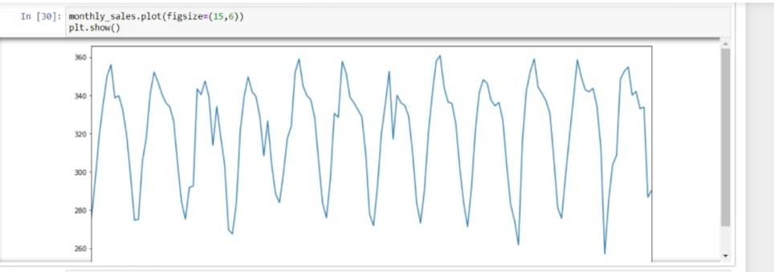
we will use the averages daily sales value for that month , and we are using the start of each month as the timestamp.

Slide 14
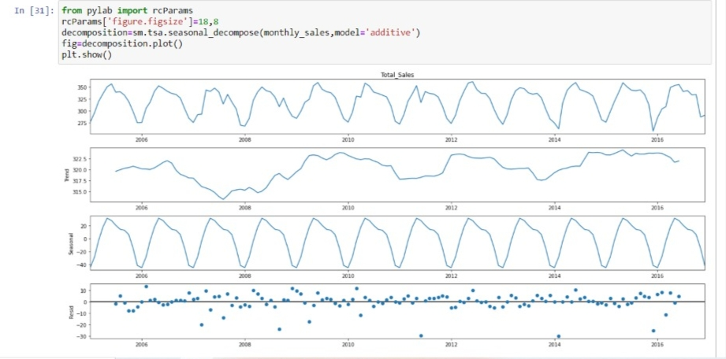
Let us visualize our data series data using the method that allows us to decompose our time

Slide 15
SOFTWARE REQUIREMENTS
Anaconda Navigator
Jupyter Notebook
Machine learning tools : pandas,
numpy ,
matplotlib
Anaconda Navigator modules : Tensorflow,
Keras

Slide 16
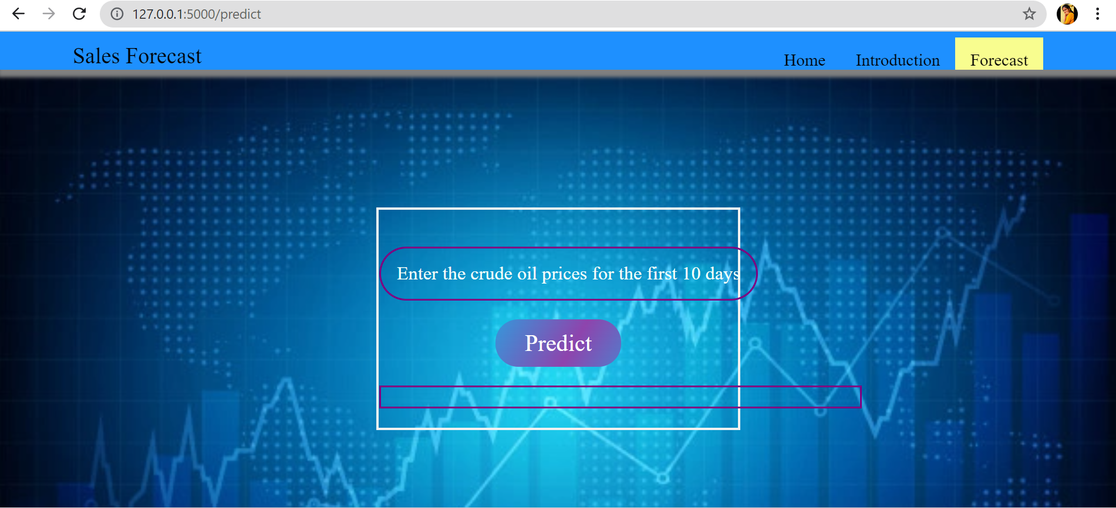
PREDICTING THE RESULTS
Here in the forecasting page we enter the sales of 10 days and predict the sales value of 11th day..

Slide 17
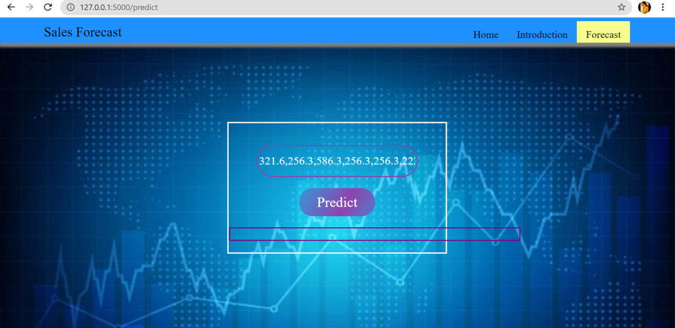
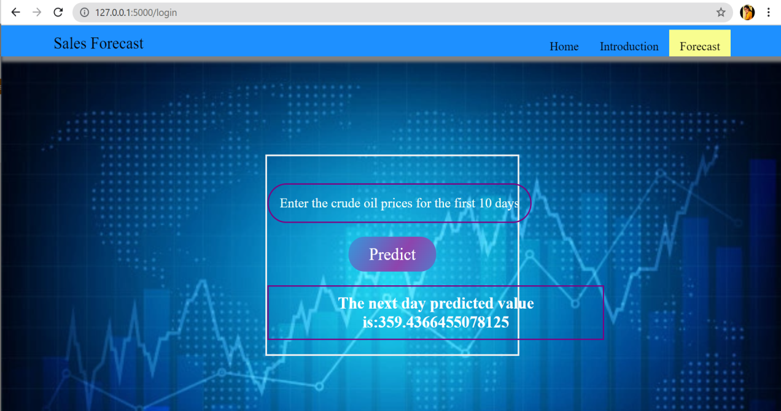
PREDICTING THE RESULTS
We enter the 10 days values
and click on predict button .
After prediction, the 11th day sales
value is displayed.

Slide 18
DEPLOYING THE MODEL ON IBM
Finally we deploy our machine learning model on IBM by firstly training the model by using IBM services namely
Machine learning service
Watson studio service

Slide 19
CONCLUSION
In this project we have done the prediction for 11th day sales of a store after entering the before 10 days sales data.
Prediction is done using LSTM and RNN algorithms.

Slide 20
THANK YOU

